Slide 1

Health Insurance Premium Prediction

Slide 2
What is Health Insurance ?
Health insurance is a type of insurance that covers medical expenses that arise due to an illness. These expenses could be related to hospitalisation costs, cost of medicines or doctor consultation fees.

Slide 3
Why is Health Insurance used?
Protects savings: Having a health insurance policy protects your savings from getting drained due to medical treatments. Medical emergencies are unpredictable, and with rising healthcare costs, quality management can get very expensive. Without medical insurance, there can be a rapid loss of savings.
What is health insurance and its benefits?
Health insurance is a type of insurance that covers medical expenses that arise due to an illness. These expenses could be related to hospitalisation costs, cost of medicines or doctor consultation fees.

Slide 4
Different Types of Health Insurance in India
Individual Health Insurance. An Individual Health Insurance plan is meant for a single person. ...
Family Health Insurance. ...
Critical Illness Insurance. ...
Senior Citizen Health Insurance. ...
Top Up Health Insurance. ...
Hospital Daily Cash. ...
Personal Accident Insurance. ...
Mediclaim.

Slide 5
Health Insurance Premium Prediction using Python?
The dataset that I am using for the task of health insurance premium prediction is collected from Kaggle. It contains data about:
the age of the person
gender of the person
Body Mass Index of the person
how many children the person is having
whether the person smokes or not
the region where the person lives
and the charges of the insurance premium
So let’s import the dataset and the necessary Python libraries that we need for this task:

Slide 6
Examples of Health Insurance Premium Prediction

Slide 7
Machine learning (ML) for the insurance industry sector
Insurance is a policy that eliminates or decreases loss costs occurred by various risks. Various factors influence the cost of insurance.
These considerations contribute to the insurance policy formulation. Machine learning (ML) for the insurance industry sector can make the wording of insurance policies more efficient.
This study demonstrates how different models of regression can forecast insurance costs.
And we will compare the results of models, for example, Multiple Linear Regression, Gener

Slide 8
How does it work
First, all inputs are preprocessed to be understandable by the machine. This is a linear regression model based on supervised learning, so the output will be provided along with the input. Then inputs are then fed to the model along with desired output. The model will plot(learn) a relation(function) between the input and output. This function or relation is then used to predict the output for a specific set of inputs. In this case, input parameters like date and previous sales are labeled as input, and the amount of sales is marked as output

Slide 9
Required packages and Installation
numpy
pandas
keras
tensorflow
csv
matplotlib.pyplot

Slide 10
Installation
import pandas as pd # to extract data from dataset(.csv file)
import csv #used to read and write to csv files
import numpy as np #used to convert input into numpy arrays to be fed to the model
import matplotlib.pyplot as plt #to plot/visualize sales data and sales forecasting
import tensorflow as tf # acts as the framework upon which this model is built
from tensorflow import keras #defines layers and functions in the model
#here the csv file has been copied into three lists to allow better availability
list_row,date,traffic = get_data('/home/abh/Documents/Python/Untitled Folder/Sales_dataset')

Slide 11
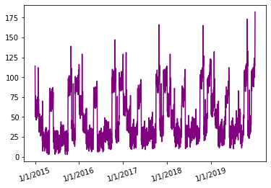
Sales Data for 5 Years
As you can see, the sales data seems to be following a similar kind of pattern for each year and the peak sales value seems to be increasing with time over the 5-year time frame.
In this 5-year time frame, the first 4 years will be used to train the model and the last year will be used as a test set.

Slide 12
Preprocessing
Initially, the data set had only two columns: date and traffic(sales).
After the addition of different columns and processing/normalization of values, the data contained all these values.
Date
Traffic
Holiday or not
Day

Slide 13
What are supervised and unsupervised techniques?
supervised learning uses labeled input and output data, while an unsupervised learning algorithm does not. In supervised learning, the algorithm “learns” from the training dataset by iteratively making predictions on the data and adjusting for the correct answer.
Some examples of unsupervised learning algorithms include K-Means Clustering, Principal Component Analysis and Hierarchical Clustering.
Some popular examples of supervised machine learning algorithms are: Linear regression for regression problems.

Slide 14
Algorithm is used for sales prediction?
The Random Forest Regression algorithm performed well after do- ing all the study when compared with other algorithms. Hence the Random Forest Regression is considered as the best suitable algorithm for forecasting product sales.
So, the overall regression equation is Y = bX + a, where:
X is the independent variable (number of sales calls)
Y is the dependent variable (number of deals closed)
b is the slope of the line.
a is the point of interception, or what Y equals when X is zero.

Slide 15
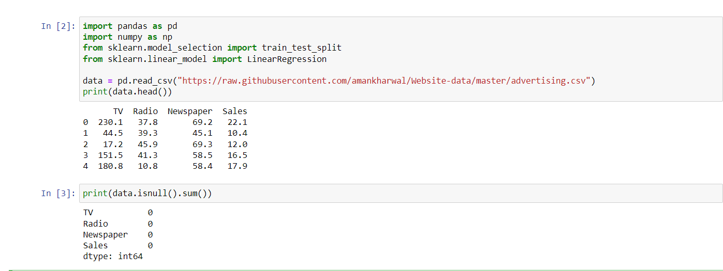
Future Sales Prediction using Python

Slide 16
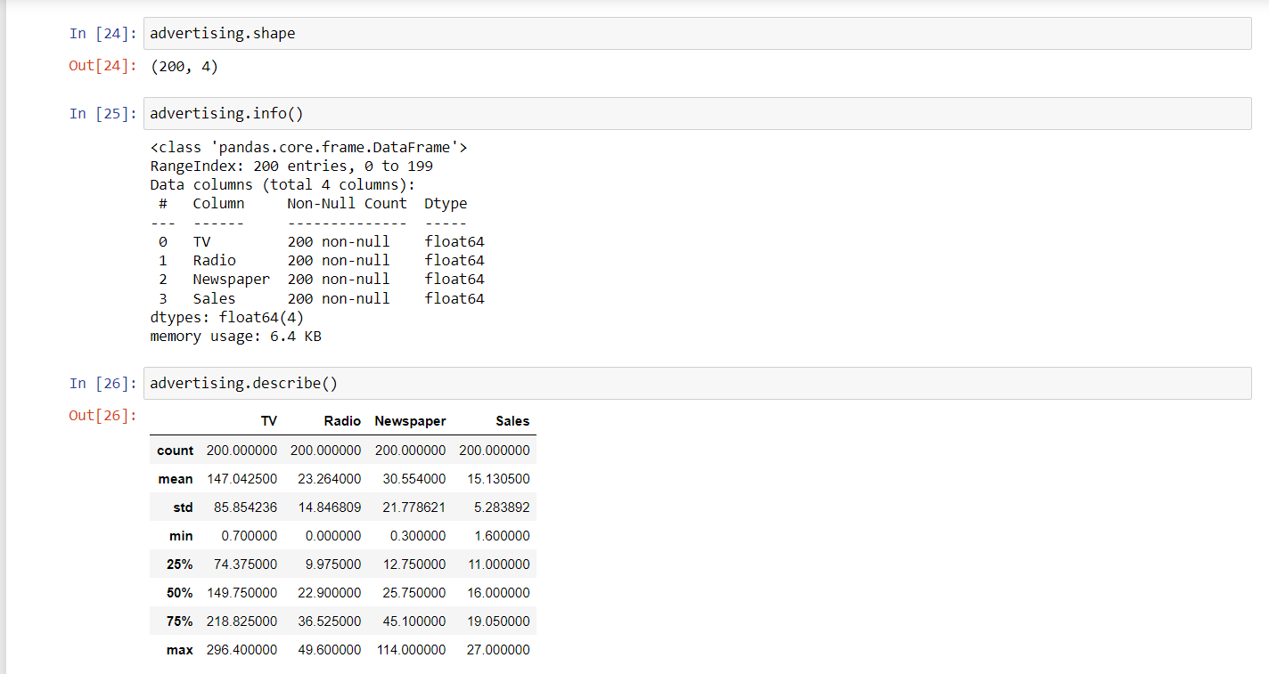
Data Inspection

Slide 17
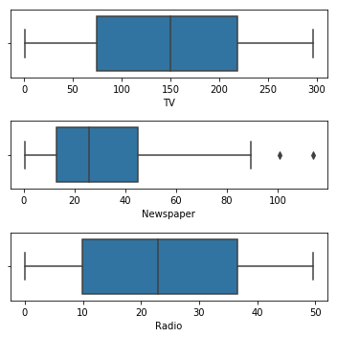
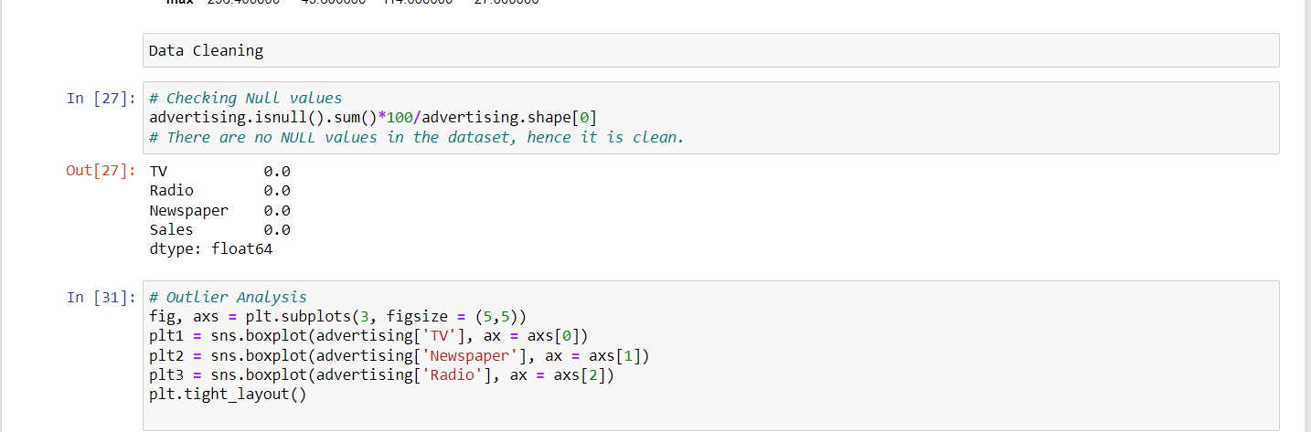
Data Cleaning

Slide 18
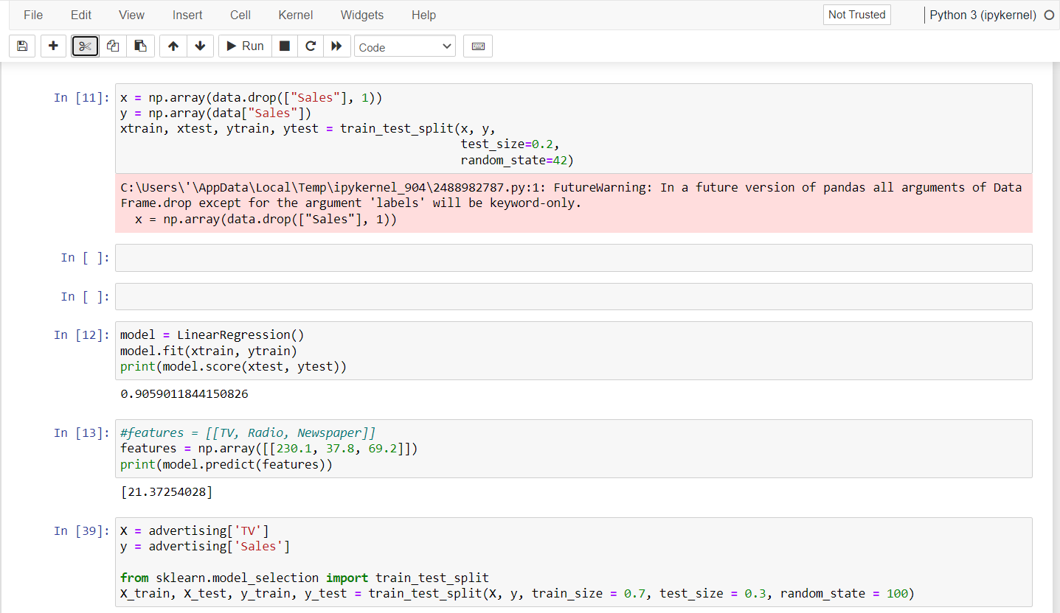
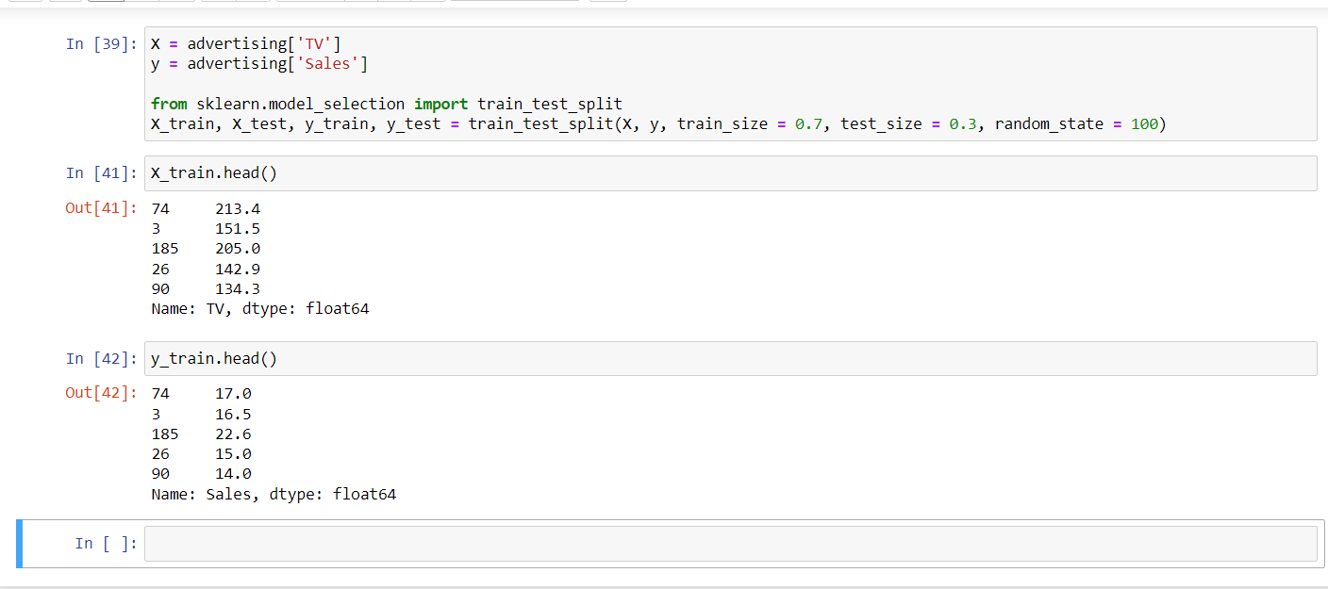
Train-Test Split

Slide 19

What is big Mart sales prediction?
The aim is to build a predictive model and find out the sales of each product at a particular store. Using this model, BigMart will try to understand the properties of products and stores which play a key role in increasing sales.

Slide 20
Future Health Insurance Premium Prediction

Slide 21
How & Why Health Insurance Premium Prediction?
Health Insurance is a type of insurance that covers medical expenses. A person who has taken a health insurance policy gets health insurance cover by paying a particular premium amount. There are a lot of factors that determine the premium of health insurance. So if you want to learn how we can use machine learning for predicting the premium of health insurance, then this article is for you. In this article, I will take you through the task of health insurance premium prediction with machine learning using Python.

Slide 22
What is the future Health Insurance Premium Prediction ?
It is an important task for an actuary in determining an appropriate premium price for each customer with different risks and characteristics.
The purpose of this study is to determine the best model for pure general insurance premiums and variables that can affect the amount of pure premiums. One of statistical analyzes that can be used to model insurance premiums is Generalized Linear Models (GLM).
GLM is an extension of the classic regression model that can accommodate the flexibility of its

Slide 23
Presented By.
Geedikapalli Mamatha and ravali godasi

